Slide 1
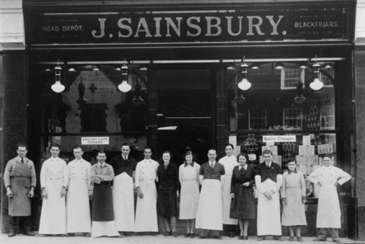



Best Online Supermarket 2021

Slide 2


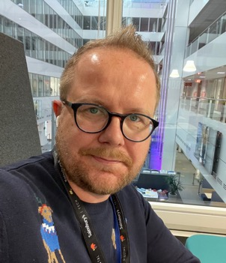
Title of image goes here
Nick Poulten
Agile Coach
Ed Carr
Agile Coach
Stuart Richards
Head of Platform Engineering

Slide 3
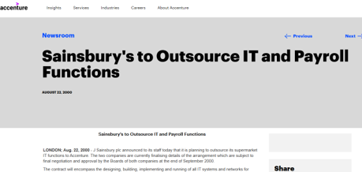
August 2000
OUTSOURCE
EVERYTHING

Slide 4

Project Initiation
Document
Requirement
Catalogue
Business Case
Gantt Chart

Slide 5

We are finding our own path…

Slide 6


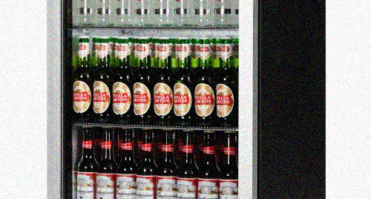

An early wrong turn…

Slide 7

We learnt:
It’s important to be inclusive and invite participation
Cultivating bottom-up grass roots change is important but sometimes top-down structural change is essential

Slide 8
Functional Organisation
CIO
Head of Architecture
Head of Delivery
Head of Product
Head of Engineering
From Functional to Divisional structures…
Project A
Project B
Project C
Divisional Organisation
CIO
Product Family A
Product Family B
Product Family C
Head of Tech
Head of Tech
Head of Tech
Architecture
Engineering
Architecture
Engineering
Architecture
Engineering
Product
Delivery
Product
Delivery
Product
Delivery

Slide 9
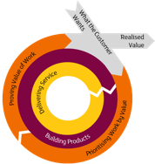
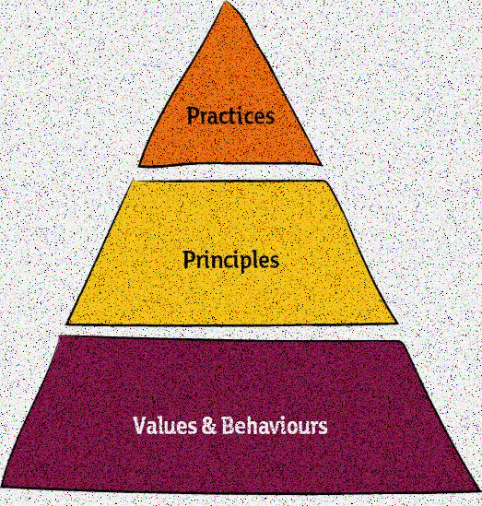
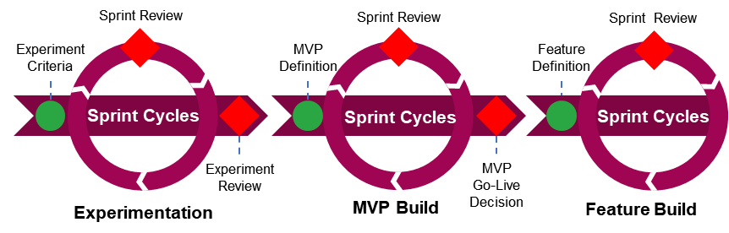











Stable and
Integrated Teams
Leadership not Management
Product Over
Project
Small and
Frequent Deliveries
Simple, Devolved
Governance
Visible, Valuable
Documentation

Slide 10

Transformation Scrum Teams

Slide 11

Go first, others will follow…

Slide 12

Put power into the hands of those who know most…

Slide 13



Introducing Product Councils…….
Investment Board
Product Council
Investment
Paper
Council Board
Product Councils
Stable, Integrated Teams

Slide 14
We learnt:
Transformation Scrum were a great way to invite participation and land change in different contexts
Brave supportive leadership is the key ingredient

Slide 15






Our tech powers the UK’s number one multi-channel, multi-brand retailer

Slide 16

DevOps Community of Interest…

Slide 17

E2EPLM Experiment Results
Availability
Pace
Sentiment
Cost
Increased resolution within SLA
Improved mean time to resolution for all incidents
Reduction in open problems
Increased rate of change
Increased change control compliance
Increased colleague happiness
Increased stakeholder Net Promoter Score
FY 20/21 reduction of £55k - £90k
FY 21/22 reduction of £228k - £280k

Slide 18

Clear purpose and accountability…

Slide 19

Looking back…

